Slide 1

Data Analytics- Power BI
MIP-DA-04Batch
By: Trapti Nagwanshi
Aim: Using Power BI to conduct a comprehensive analysis of Indian agriculture.
Description: The following project is a part of MENTORNESS Data Analyst Internship which will help to develop data analysis skills in a practical context. By using various visualizations, filters and modelling features. So, herby creating a PPT presentation which includes all the findings and statistics related to the dataset.

Slide 2
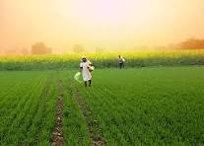
Project 2: Indian Agriculture Analysis
Problem Statement:
The internship project aims to delve deep into the realm of Indian agriculture, focusing on analyzing data from different districts and years. This dataset provides extensive information on various crops, including their cultivation areas, production quantities, and yields across diverse regions and time periods. Using Power BI, the goal is to create dynamic visualizations that uncover valuable insights into agricultural trends, patterns, and disparities. By doing so, stakeholders will be equipped with the knowledge needed to make informed decisions regarding sustainable farming practices and resource allocation.

Slide 3
Project Objectives:
Data Exploration: Explore the dataset to understand the distribution of agricultural variables across districts and years.
Crop-specific Analysis: Analyze the trends in the cultivation of major crops, including rice, wheat, and pulses, focusing on changes in area, production, and yield.
Regional Disparities: Identify disparities and variations in agricultural practices and outcomes across different districts and states.
Seasonal Patterns: Explore seasonal patterns in crop cultivation, considering kharif and rabi seasons.
Impact of External Factors: Investigate the impact of external factors like weather conditions on crop performance.
Fruits and Vegetables Analysis: Analyze the cultivation trends of fruits, vegetables, and their overall contribution to agricultural practices.
Sustainable Farming Insights: Derive insights that can contribute to promoting sustainable farming practices and optimizing resource allocation.

Slide 4
Dataset Description : The dataset contains a wide array of agricultural data, covering key variables such as the areas dedicated to crop cultivation, the quantities of crops produced, and the resulting yields. It includes information on a diverse range of crops, including staples like rice and wheat, as well as sorghum, millets, pulses, oilseeds, sugarcane, and more.
Deliverables:
Interactive Power BI dashboards providing insights into year-wise and district-wise agricultural patterns.
Visualizations depicting trends in major crops and their variations over time.
Reports on regional disparities, seasonal patterns, and the impact of external factors.
Recommendations for policymakers and stakeholders in the agriculture sector.
This project provides interns with an opportunity to gain hands-on experience in agricultural data analysis and visualization using Power BI, contributing valuable insights to enhance agricultural practices and decision-making in India

Slide 5
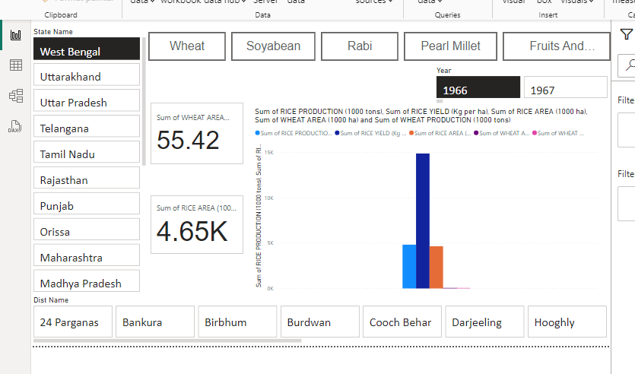

Slide 6
Description:
The above slide gives us an idea of one of the major crops in India, wheat and rice. One could easily get the yield of wheat and rice of a particular region of their choice which involves the state and their respective districts. The card shows us the yield count and the area chart gives us the trend that yield is increasing yearly.
Features used:
Advanced slicer
Clustered Column Chart
Card
Measure
Page navigation(buttons)

Slide 7
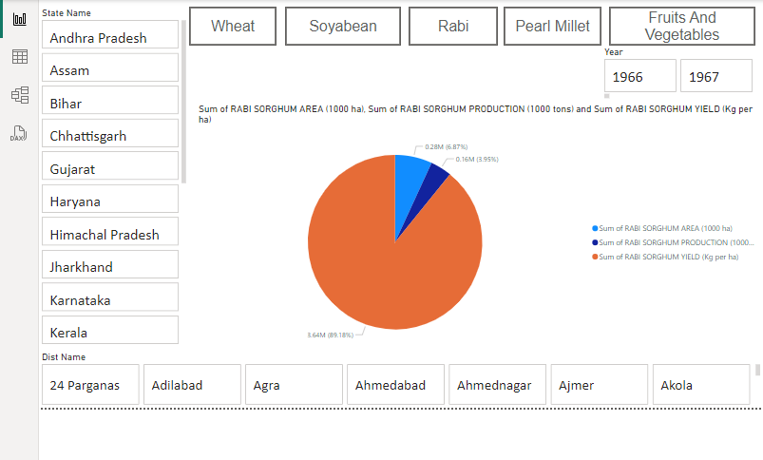

Slide 8
Description:
The above slide gives us an idea of rabi crops which are particularly sown after the monsoon and involves less water. The crops which we included are wheat, barley, chickpea and rabi sorghum. The Clustered column Chart clearly shows that wheat has the highest overall yield whereas rabi sorghum has the lowest overall yield. We can also select the state, district and year according to the need and view the statistics.
Features used:
Advanced slicer
Pie Chart
Card
Measure
Page navigation(buttons)

Slide 9
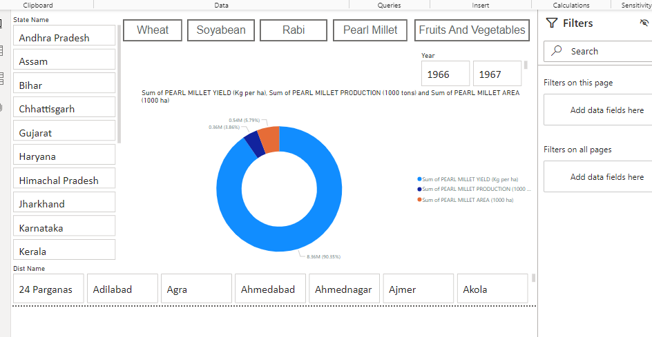

Slide 10
Description:
The above slide gives us an idea of Pearl Millet which are particularly sown after the monsoon and involves less water. The crops which we included are wheat, barley, chickpea and rabi sorghum. The pie Chart clearly shows that wheat has the highest overall yield whereas rabi sorghum has the lowest overall yield. We can also select the state, district and year according to the need and view the statistics.
Features used:
Advanced slicer
Donut Chart
Card
Measure
Page navigation(buttons)

Slide 11
Suggestions for policymakers and stakeholders in the agriculture sector:
Emphasize Sustainable Practices: Encourage investments in sustainable agricultural methods like organic farming, agroforestry, and precision agriculture. Financial incentives such as grants and subsidies can incentivize farmers to adopt these practices.
Foster Technology Adoption: Advocate for the adoption of modern agricultural technologies such as precision farming, IoT devices, drones, and genetic engineering. These technologies can boost productivity, reduce resource usage, and mitigate environmental impacts.
Prioritize Education and Training: Develop training programs and educational resources to educate farmers on sustainable farming practices and modern technologies. This can enhance adoption rates and overall productivity.
4. Promote Diversification: Encourage farmers to diversify their crops and livestock to mitigate risks from climate change, pests, and diseases. This could involve promoting climate-resilient crops and integrating livestock into crop production systems.

Slide 12
5. Policy Coherence: Ensure coherence and coordination across different policy areas relevant to agriculture, including environmental protection, rural development, trade, and food security. This can help avoid conflicting policies and maximize the synergies between different policy objectives.
6. Research and Innovation: Invest in agricultural research and innovation to develop new technologies, practices, and crop varieties that can address emerging challenges such as climate change, pests, and diseases. This could involve collaboration between government agencies, research institutions, and private sector stakeholders.
By implementing these recommendations, policymakers and stakeholders can promote sustainable agriculture, enhance food security, and support the livelihoods of farmers while also addressing environmental challenges and promoting economic development in rural areas.

Slide 13
THANKS

